Slide 1
Return to R-Land
27th July 2018
Murty MVR
071602: 2007-12
Azad Bhawan: 2008-12
Litta: 2007-

Slide 2




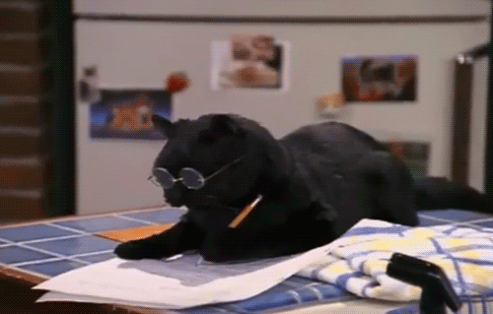
Work (it) out
No negatives for guessing. Positives for a fun answer.
15 Infinite Pounce Clockwise +10/-10 on the pounce +10/0 on the bounce
1 Written Round
15 Infinite Pounce Anti-Clockwise +10/-10 on the pounce +10/0 on the bounce
1 Basterland / A se AA tak

Slide 3

Egypt
Russia
Saudi Arabia
Uruguay
Spain
Morocco
Iran
Portugal
Serbia
Costa Rica
Brazil
Switzerland
France
Peru
Australia
Denmark
Croatia
Argentina
Nigeria
Iceland
England
Belgium
Panama
Tunisia
Senegal
Poland
Japan
Colombia
Germany
Mexico
Sweden
South Korea

Slide 4
Egypt
Russia
Saudi Arabia
Uruguay
Spain
Morocco
Iran
Portugal
Serbia
Costa Rica
Brazil
Switzerland
France
Peru
Australia
Denmark
Croatia
Argentina
Nigeria
Iceland
England
Belgium
Panama
Tunisia
Senegal
Poland
Japan
Colombia
Germany
Mexico
Sweden
South Korea
Celebrating the losers!

Slide 5
Question
Text

Slide 6
Hide your answers!

Slide 7
Answer

Slide 8
Question 1
This theory’s invention is credited to a Hungarian writer, Frigyes Karinthy, who in 1929, wrote in a short story that “Planet Earth has never been as tiny as it is now.” If Facebook is to be believed, it is now tinier, estimating the number at 3.57, as opposed to Karinthy’s 6.0.
What theory is this, usually expressed in a four-word phrase?

Slide 9
Hide your answers!

Slide 10
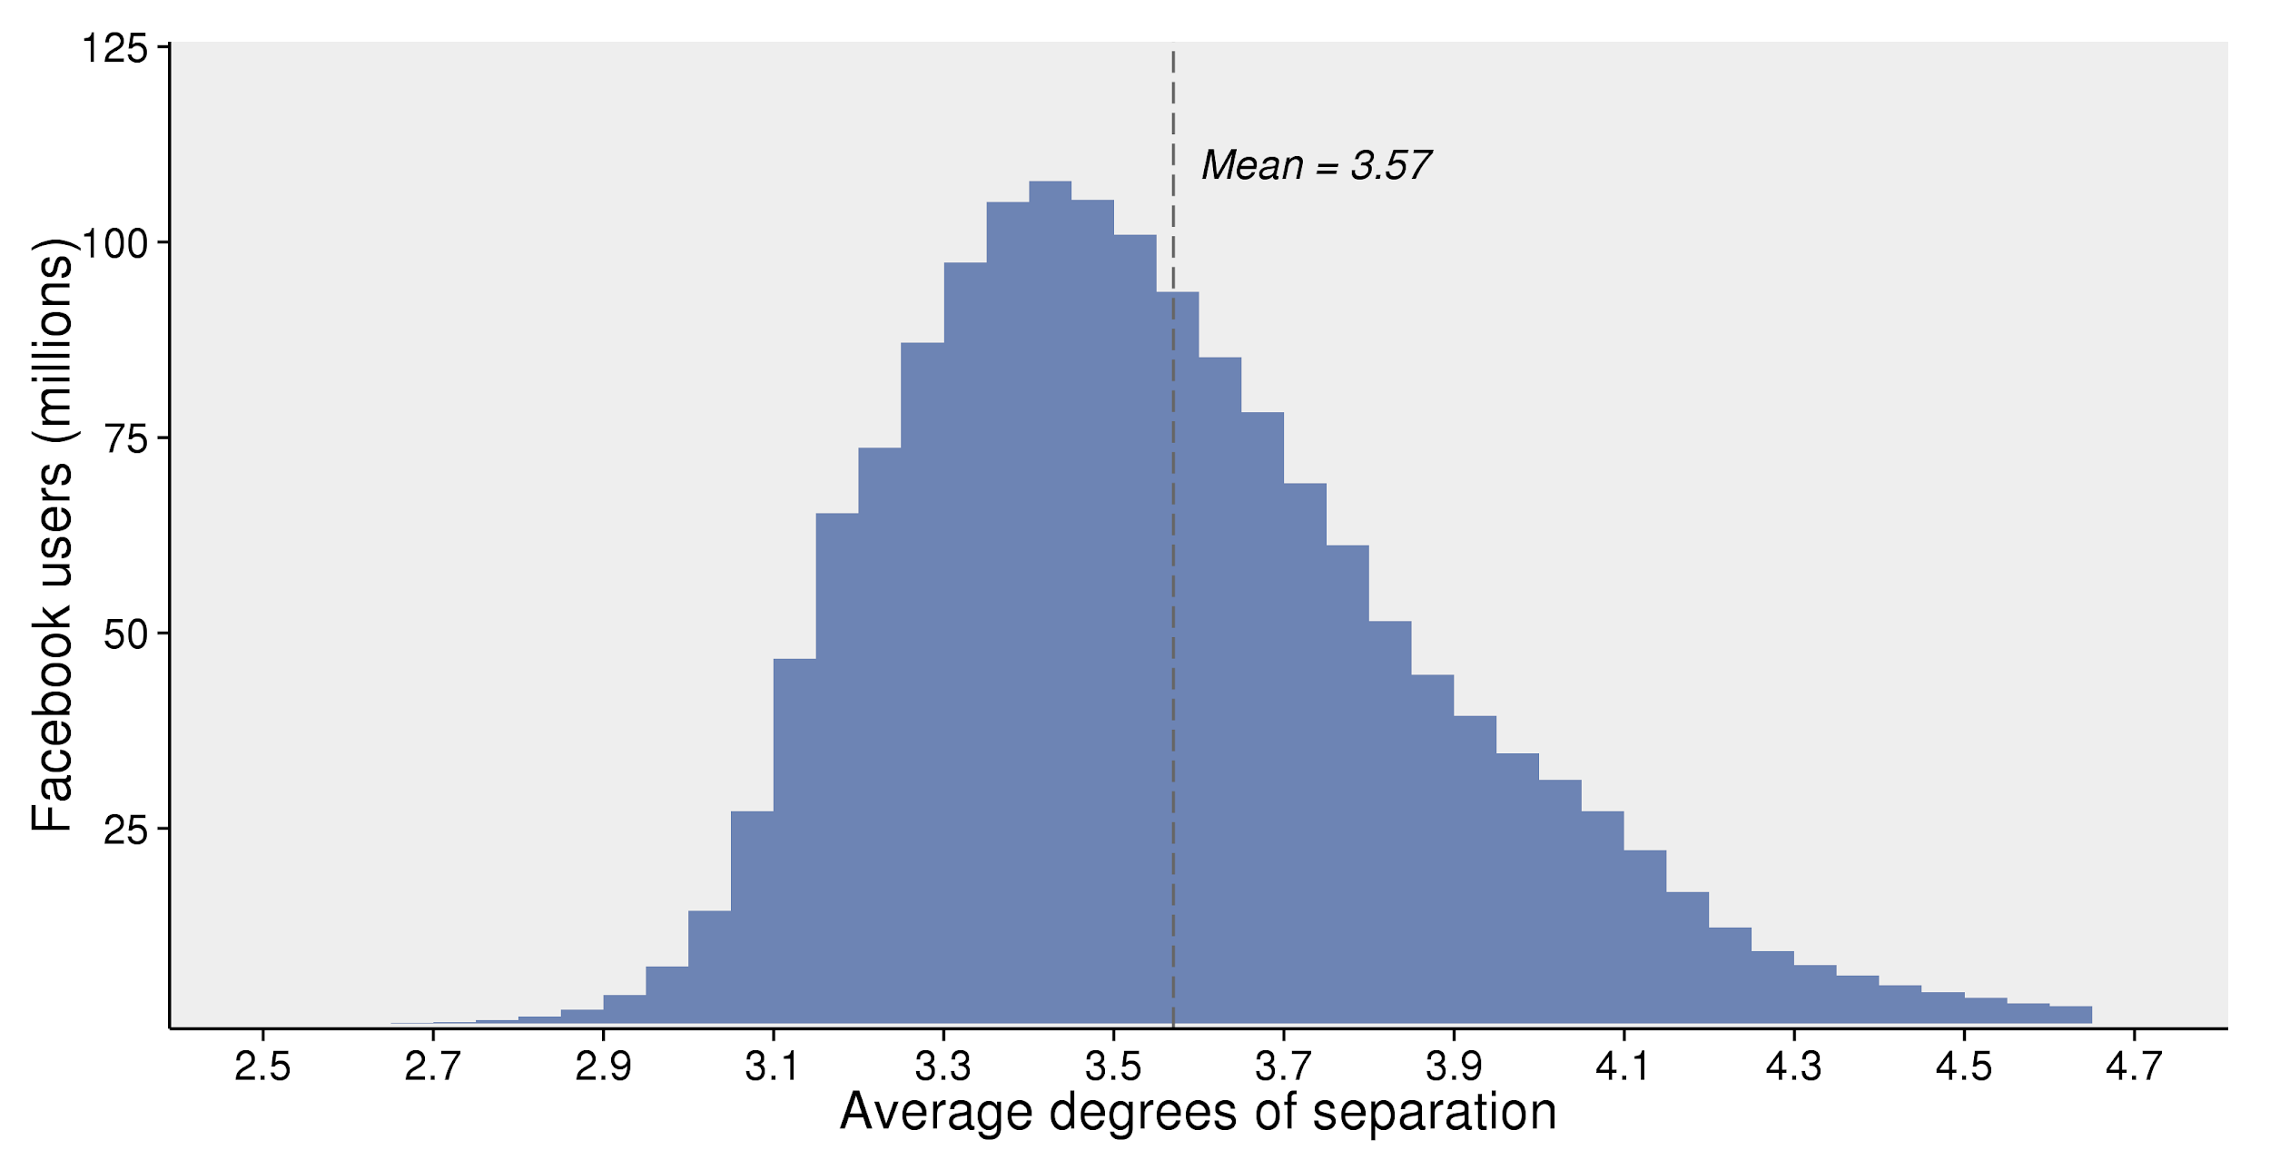
Six degrees of separation

Slide 11
Question 2
Here are a couple of extracts from “X - The Confusing Country”, an essay by one of my favourite authors, Douglas Adams. Simply identify which country he’s talking about.
The second confusing thing about X are the animals. They can be divided into three categories. Poisonous, Odd, and Sheep. It is true that of the 10 most poisonous arachnids on the planet, X has 9 of them. Actually, it would be more accurate to say that of the 9 most poisonous arachnids, X has all of them. Though, there are curiously few snakes, possibly because the spiders have killed them all.

Slide 12
Question 2 (continued)
At this point, we would like to mention the Platypus, estranged relative of the mammal, which has a duck-bill, otter's tail, webbed feet, lays eggs, detects it's aquatic prey in the same way as the electric eel, and has venemous barbs attached to its hind legs, thus combining all 'typical' X-ian attributes into a single improbable creature.

Slide 13
Hide your answers!

Slide 14
Australia

Slide 15
Question 3
While the US boycott of the 1980 Moscow Olympics and the Soviet boycott of the 1984 Los Angeles edition are the most well-known, the very first major boycott of an Olympics was in 1976, in Montreal.
22 African Nations boycotted the Olympics, as the IOC refused to ban New Zealand from the Games. The uproar was caused by a tour of the New Zealand rugby team earlier that year. Why the uproar?

Slide 16
Hide your answers!

Slide 17

They toured apartheid South Africa

Slide 18
Question 4
In 2011, a newly-discovered fungus was named by its discoverers as Spongiforma _____________, after a TV character.
It’s shaped like a sea sponge, and has a fruity, or musty smell. In addition to its resemblance to a sea sponge, under a scanning electron microscope, the spore-producing area of the fungus looks like a seafloor carpeted in tube sponges, said the researchers.
This further convinced them to name the species after the character.
After whom was it named?

Slide 19
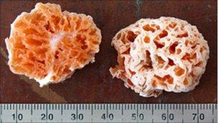

Slide 20
Hide your answers!

Slide 21

Spongebob Squarepants
(Spongiforma Squarepantsii)

Slide 22
Question 5
Commissioned in 1921 and finished in 1924, Queen Mary's Dolls' House was a gift planned for Queen Mary by her cousin, Princess Marie Louise. It was an elaborate miniature of the royal palace and its many rooms, with details so intricate, that the shotguns in the house load and crack, there’s a running water supply, as well as electric lighting and even miniature crown jewels!
Obviously, such an elaborate job, would require the best craftsmen, architects and engineers of the time. So, Princess Marie Louise asked X, one of the most famous of his kind at the time, to design this 1:12 scale model. <Image on next slide>
Incidentally, X's name is now used a pejorative in the world of Internet comments, to refer to sycophants loyal to one country’s previous establishment.

Slide 23
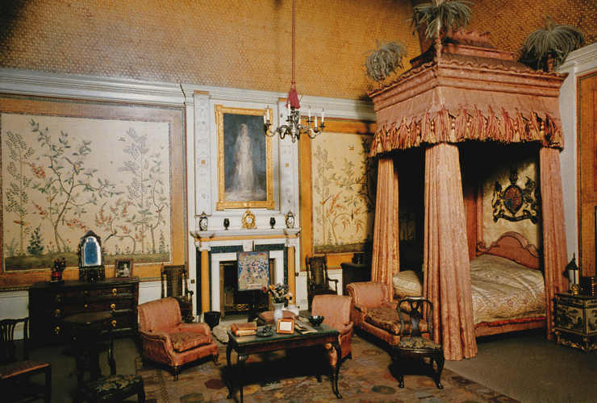


Slide 24
Hide your answers!

Slide 25
Sir Edwin Lutyens

Slide 26
Question 6
The prestigious Scripps National Spelling Bee in the US has come to be dominated by Indian-Americans in the last couple of decades, with each of the last 11 editions being won by them, as well as 15 of the 19 in this century.
The first Indian-American champion, though, was back in 1985, when 13-year-old Balu Natarajan spelled milieu for the win. Fellow 13-year-old Kate Lingley finished runner-up after misspelling a word that means “a confused mixture”.
Curiously, searches for this word in India spiked in May 2017. What’s the good word?

Slide 27
Hide your answers!

Slide 28

Farrago

Slide 29
Question 7
<Image on next slide> This is an image from the cover for the Economist’s June 23rd-29th edition this year.
Nice and simple - what last is it referring to?

Slide 30


Slide 31
Hide your answers!

Slide 32

Saudi Arabia becomes the last country to allow women to drive

Slide 33
Question 8
The Iranian national team at the World Cup was in the news just before the tournament, claiming their participation in the tournament was jeopardised.
“What Nike did to us was very wrong," forward Karim Ansarifard told ESPN. “I can tell you, as a footballer, we don't compare diplomatic and political problems to sports.”
Adidas, Nike’s German rival, jumped at the opportunity to one-up their rival. “We equip the Iranian team because a lot of Iranians love football, and at the end of the day we believe in sport,” its CEO Kasper Rorsted told Russia’s RT.com. “We believe that through sport we have the power to change lives.”
Nike, meanwhile, claimed the story was misleading.
What did Nike do (or not do) to the Iran men’s football team?

Slide 34
Hide your answers!

Slide 35
Nike couldn’t send shoes to the team because of US sanctions against Iran

Slide 36
Question 9
Of the more politically interesting groups in the World Cup, Group E has made quite a mark in the tournament.
After a 1-0 win in the opening round, Serbia’s foreign minister Ivica Dacic, said “The victory over the team of Costa Rica was one small, sweet revenge.”, as the Central American Country was one of the first to recognise an act in 2008 that Serbia continues to strongly detest.
This was brought to the fore in their next game, when Switzerland’s goalscorers, Granit Xhaka and Xherdan Shaqiri, both performed a celebration for which both were later fined. <Picture on next slide>
What event in 2008 was the Foreign Minister referring to?

Slide 37


Slide 38
Hide your answers!

Slide 39
Kosovo’s declaration of independence from Serbia

Slide 40
Question 10
Egypt’s Presidential Elections in March 2018 were widely considered a farce, with many neutral observers noting that they were neither free nor fair. At least five major opposition candidates were either sidelined or jailed in the lead-up to the vote. The only opposition to incumbent Abdel Fattah el-Sisi was a little-known pro-Sisi politician, Moussa Mostafa Moussa.
With 41% turnout, Sisi won 97% of the vote; Moussa gathered only ~650,000 votes. Of the 1.5 million ballots considered invalid, some reports said that about a million had crossed out both candidates’ names, and written X’s name instead. This would mean that the globally popular X finished 2nd in the Egyptian presidential election! Who?

Slide 41
Hide your answers!

Slide 42

Mohamed Salah

Slide 43
Question 11
Much of Iceland’s football team is very famous now, with Premier League stars like Everton’s Gylfi Sigurdsson and Burnley’s Johann Berg Gudmundsson.
One squad member - Albert Gudmundsson, a 21-year-old winger who plays for PSV - isn’t as famous as his father, though. Gudmundur Benediktsson (fondly called Gummi Ben) had 10 caps for Iceland as a striker, scoring two goals. He also had a brief managerial career till 2016, after which he became world-famous thanks to what?

Slide 44
Hide your answers!

Slide 45

Crazy Iceland commentator at Euro 2016

Slide 46
Question 12
At the end of the 19th century, rumour spread in Japan that a country called X, somewhere on the opposite side of the earth was “full of gold”. According to ads by emigration agents, this country was a paradise, with mild climate, rich soil for farming, familiar dietary customs and no epidemics.
This is believed to be the story of how the Japanese-origin community arrived in X. Their most famous representative Alberto Fujimori, led the country from 1990 to 2000, before being sentenced to 25 years in jail for corruption and human rights abuse. Which country is X?

Slide 47
Hide your answers!

Slide 48
Peru

Slide 49
Question 13
In early June, as international friendlies were being played before the start of the World Cup, reports emerged of an ingenious idea by the Tunisian team.
A few minutes into the second half of evening games against European champions Portugal and Turkey, the Tunisian goalkeeper would go down claiming an injury, and the referees would stop play to help provide him treatment, allowing the rest of the team to take refreshments.
These breaks re-energised the team, and they’d go on to draw both games 2-2. Why was the keeper feigning these injuries?

Slide 50
Hide your answers!

Slide 51
To break their fast at sunset with iftar - they had dates and water during the break

Slide 52
Question 14
This three-letter word could refer to so many things.
It was the capital of the Kingdom of Morocco till 1927, and still the 3rd largest city after Casablanca and Rabat.
A fashion accessory named after said city, that one Doctor Who thinks is cool.
A character from a TV show of unknown nationality, whose name might just come from Foreign Exchange Student

Slide 53
Hide your answers!

Slide 54


Fez

Slide 55
Question 15
The biggest political victim of the storm surrounding the Panama Papers was possibly former Pakistan PM, Nawaz Sharif.
His daughter was accused of buying luxury properties in London through offshore companies in 2006. Her team produced documents claiming she was only a trustee in those companies, and not an owner.
However, the fact that the documents were typed in a particular font helped nail the lie, leading to Pakistani social media deriding Sharif’s family’s lies through the hashtag #fontgate.
How was the lie caught?

Slide 56
Hide your answers!

Slide 57
Calibri was only released in 2007, with Windows Vista

Slide 58

Arre Baba, bas!
Written round
Identify the artists Baba Sehgal’s tagged in his tweets +5 for each correct answer +5 bonus for getting them all
Example follows
Sorry for this round! :D

Slide 59
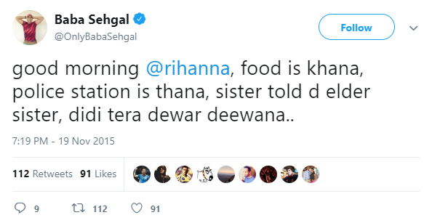
Example

Slide 60
Rihanna

Slide 61
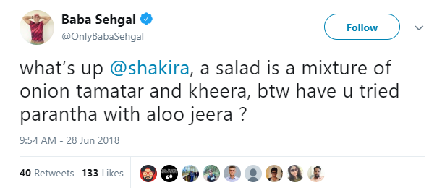
1

Slide 62

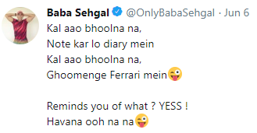
2

Slide 63

3

Slide 64
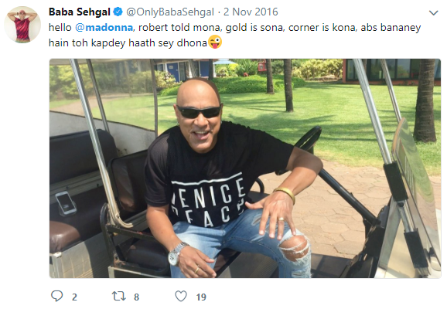
4

Slide 65
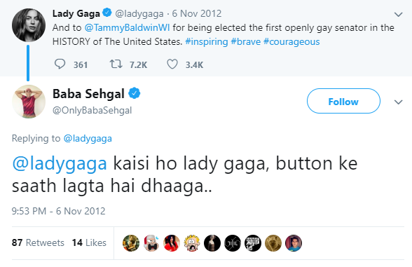
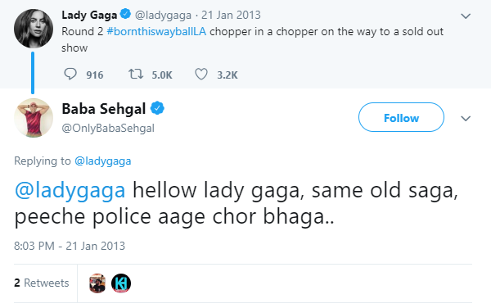
5

Slide 66
Exchange sheets!

Slide 67
1

Slide 68
Shakira

Slide 69
2

Slide 70
Camilla Cabello

Slide 71
3

Slide 72
Katy Perry

Slide 73
4

Slide 74
Madonna

Slide 75
5

Slide 76
Lady Gaga

Slide 77

Scores, please?

Slide 78
Question 16
Nigeria’s former capital, Lagos, is experiencing an economic revival, over the last two decades. The city generates a third of Nigeria’s GDP, and like Mumbai in India, is not only a major business centre, but also home to a thriving music, film and fashion scene.
In fact, its economy is bigger than that of the entire country of Kenya. But, there’s one area where it seeks to emulate Kenya - driven by m-Pesa, and huge adoption of social media, Kenya’s capital, Nairobi, is a hub for technology and start-ups.
By what two-word alliterative phrase, reminiscent of California but containing an African geographical feature, is this area known?

Slide 79
Hide your answers!

Slide 80
Silicon Savannah

Slide 81
Question 17
Swedish-born composer Ludwig Göransson, after weeks of research, toured Senegal with its superstar musician, Baaba Maal, to capture its sounds - the most memorable of which ended up being an instrument popularly known as the “talking drums”.
Afterwards, Göransson went back to London, mixing the sounds he recorded in Senegal with a 92-piece orchestra, and a choir that sang in Xhosa, a South African language.
What soundtrack was all this work for?

Slide 82
Hide your answers!

Slide 83

Black Panther (Play from 1:10)

Slide 84
Question 18
While one may wonder if it comes from South Korea’s closeness to the USA after the Korean War, the name of South Korea’s presidential residence actually relates to a Korean phrase.
The official name in Korean, Cheong Wa Dae, literally means “pavillion of blue tiles”. What’s it popularly called in English? <Picture on next slide>

Slide 85


Slide 86
Hide your answers!

Slide 87
The Blue House

Slide 88
Question 19
A bizarre incident occurred at the medals ceremony for the Women’s 75m trap event at the Arab Shooting Championships in Kuwait, in 2012.
Kazakh gold medallist Maria Dmitrienko listened expressionless as the “national anthem” being played praised Kazakhstan’s prostitutes for being the “cleanest in the region - except, of course, for Turkmenistan’s” while asserting that other countries “have inferior potassium” and are “run by little girls”.
What happened?

Slide 89
Hide your answers!

Slide 90

They played a parody anthem from Borat

Slide 91
Question 20
Digital and home delivery subscribers of the New York Times (popularly known just as the Times) can view articles dating all the way back to 150 years, just as they were seen in the actual newspaper, transporting you to that era.
<Picture on next slide>
What is this product very aptly named?

Slide 92


Slide 93
Hide your answers!

Slide 94
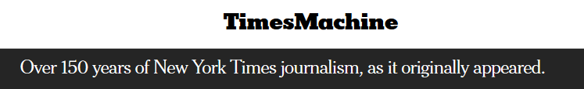
The TimesMachine

Slide 95
Question 21
Researchers in 2012 discovered a new species of ant not in some far-off tropic, but right in the middle of New York City, living in the medians between 63rd and 76th streets.
They believed the ant may have evolved due to its isolation in NYC, adapting to the drier, urban environment. It may even have a taste for junk food - one scientist noted high amounts of carbon in its body, a symptom of a high corn-syrup diet from New York’s junk food.
Newspapers had a blast reporting this, and punnily named it X, after New York’s most famous borough.

Slide 96
Hide your answers!

Slide 97
Manhattant

Slide 98
Question 22
As part of a BBC Series, “The Secrets of Your Food”, Michael Mosley went into the composition of chocolate, trying to find out why it was so universally popular.
Of the many hypotheses, one theory is about chocolate’s similarity to X - X has 4% fat and 8% sugar, chocolate 11% and 22%, respectively. This 1:2 ratio of fat and sugar, is rare among foods, and it could be that when eating chocolate (or other foods with these ratios, like biscuits and doughnuts), we’re recapturing the taste, and sense of closeness we got from X, one of the first foods we all had. What’s X?

Slide 99
Hide your answers!

Slide 100
Breast Milk

Slide 101
Question 23
While British distance runner Mo Farah is celebrated for his stupendous Olympic achievements, till October 2017, he was also the Guinness world-record holder in an unlikely event - the 100m Y race. It was broken, however, by a 37-year-old British graphic designer, Stephen Wildish, last year - he clocked at 26.2 seconds, shattering Farah’s record by more than 13 seconds.
Speaking to the press afterwards, he said, “You get some funny looks when you’re on the treadmill in a Y” and advised future aspirants to focus on “anything that’s bouncy… jumping around, trampolining - anything that’s good for your calves”.
In which event - one that many of us might also have taken part in - did Wildish shatter Mo Farah’s world record?

Slide 102
Hide your answers!

Slide 103

Sack Race

Slide 104
Question 24
Inside an austere building in a small town in southwestern Germany is the headquarters of a small government branch with a long name (COSJAINSC). The department has an annual budget of 1.2m euros, with which they pursue investigations not only in Germany and neighbours Poland and Austria, but also in distant Russia and even some South American countries.
Even their youngest suspects are about 90 years old now, only six of their cases have gone to trial in this century, and the public has mixed emotions about the dept. - some view it with reverence for pursuing difficult cases against heavy odds, while others question the point of putting a 90-year-old in jail.
What cases does this department investigate?

Slide 105
Hide your answers!

Slide 106

Prosecuting former Nazis

Slide 107
Scores, please!

Slide 108
Question 25
In the Australian state of Queensland, pet rabbits are illegal. Classified as a “restricted invasive animal”, the Department of Agriculture and Fisheries notes that “Rabbits are Australia’s most destructive agricultural and environmental introduced animal pest, costing up to $1 billion annually.”
This is due to the damage they cause to crops (by munching on them) and land (by digging burrows). Also, because they breed like - well - rabbits, their population is hard to control, too. Thus, the rule.
There are only two exceptions when a permit can be provided to keep domestic rabbits. One is “scientific and research purposes”, while the other is “certain forms of public entertainment, such as X and circuses”? What form of entertainment allows one to own a pet rabbit in Queensland?

Slide 109
Hide your answers!

Slide 110
Magic Shows

Slide 111
Question 26
I’m reading a book called “Billionaire Raj” by former FT journalist James Crabtree, that talks about the lavish billionaire class in an extremely unequal India.
A large part of the book compares this era in India to America’s Gilded Age, and the Ambanis and Mallyas of today to the Robber Barons like Vanderbilt and Rockefeller.
But one term across the book cleverly references a commonly used term for today’s Russia, where a few billionaires have made huge fortunes by being close to Putin, and adding an Indian movie touch to that word. What’s the pun referring to these few Indians?

Slide 112
Hide your answers!

Slide 113
Bollygarchs

Slide 114
Question 27
The Grey Album is a 2004 mashup album by Danger Mouse, one of the musicians in the duo, Gnarls Barkley.
Its name comes from the fact that it combines elements of songs from the album A by the artist X, with samples from the album B by the band Y. It got into a controversy when record company EMI threatened to sue Danger Mouse, despite approvals from X and the surviving members of Y.
Who are X and Y, and what are the albums A and B?

Slide 115
Hide your answers!

Slide 116


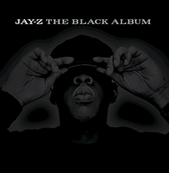
X - Jay Z, A - The Black Album
Y - The Beatles, B - The White Album
=
+

Slide 117
Question 28
This word’s origin comes from the Latin roots com (meaning with) and _____ (meaning bread). So, the word literally means “someone to break bread with”.
The Latin root for bread gives the French word pain (you might have seen it in the chain, Le Pain Quotidien) and also finds it way into India through Portuguese, where the Goan bread is called Pao.
What’s the good word, that literally means “someone to break bread with”?

Slide 118
Hide your answers!

Slide 119
Companion

Slide 120
Question 29
X originally was used to refer to grease and fat from meat cooked on a ship. Since ships used to go on long voyages, where food was cooked often, at the end of a voyage, a ship would acquire lots of this grease and fat.
This was used in making candles, so the captain of these ships would make a large chunk of money at the end of the voyage by selling this refuse grease and fat. This was then used for items like books and musical instruments for the crew.
Over time, X acquired negative connotations, though, with the phrase X Fund beginning to mean funds used for bribing public officials. What’s X or the phrase?

Slide 121
Hide your answers!

Slide 122
Slush Fund

Slide 123
Question 30
The name for this endangered mammal comes from the Carib word for “breast”, as early people mistook them often for mermaids!
Both the German (Rundschwanzseek) and Portuguese (peixe-boi) names for the mammal refer to its bovine nature, and even its most common English name does the same.
What endangered species, mocked in South Park as the creative force behind Family Guy, is this?

Slide 124
Hide your answers!

Slide 125
Manatee

Slide 126
A se AA tak!
27 Variables, one long story Here’s one story with 27 answers within it - ideally, you should be able to work out the entire tree from any point in the story.

Slide 127
A se AA tak - Page 1/5
The case of the murder of Sindhi businessman, A, by naval officer B over an affair with his wife, C, was one of India’s most sensational cases about six decades back. B had come back from a long voyage, when a cold and distant C admitted to having an affair with A. Later that afternoon, B walked over to A’s house, barged into his bedroom, and with his service pistol, shot the only-towel-clad A.
The trial was heavily publicised, especially in the Mumbai tabloid Blitz, which compared B to the mythological character, D, saying it was his dharma to slay the villain E, who had abducted D’s innnocent wife F. The influence of Blitz on key members of the trial, led to a key change in India’s judiciary - the abolishment of trial by G.

Slide 128
A se AA tak - Page 2/5
The famous trial has even been adapted into Bollywood movies thrice.
The first was Yeh Raaste Hain Pyaar Ke in 1963, the directorial debut of legendary actor, H. Incidentally, H’s son, I, was also the subject of a biographical film in 2018, directed by J, which is currently the 2nd largest-grossing movie of the year, and is projected to take over Padmaavat in the coming weeks. In the movie, I is played by another star son, K.
The second adaptation was Achanak in 1973, directed by legendary lyricist and poet, L. Nominated for the Filmfare Best Director award, he won it two years later for the film, Mausam. He’s won multiple Best Lyricist awards there, the Dadasaheb Phalke award in 2013, and even shared an Academy Award for Best Original Song in 2013 for the song M, with the music director, N in the movie O.

Slide 129
A se AA tak - Page 3/5
The third and most recent cinematic adaptation of the case was in 2016, called P starring Q, as the naval officer (B), and R, as his wife (C). Incidentally, the full name of the lead character in P was the same as that of a doctor in the 2003 movie S, directed by J and starring I. The movie, where I plays the lead character who’s a fraud medical student, is widely credited with reviving I’s career in Bollywood.
Incidentally, the case was also referenced in the multiple Booker-prize winning novel, T, by acclaimed Indian-origin writer U. In the book, the protagonist, who was born a little under 71 years from today, finds out that Commander Sabarmati’s wife is having an affair. The Commander proceeds to kill both his wife and her lover.

Slide 130
A se AA tak - Page 4/5
The streaming company, V, which originally started off as a DVD-rental firm, announced recently that it’s adapting the novel S into a TV series. V also recently released its first India-based TV show, W, based on the eponymous novel by author, X.
The series stars another star-son, Y, whose sister, Z, incidentally starred in Deepa Mehta’s movie adaption of the novel, S. Y and Z’s father was a former Indian cricket captain, AA. The legendary AA was a great cricketer despite a car accident that left him blind in one eye. He’s honoured with an annual lecture by the BCCI that was started in 2013.

Slide 131
A se AA tak - Page 5/5
Nah, just kidding. We’re done. :)

Slide 132
Hide your answers!

Slide 133
Answer
A - Prem Ahuja
B - Kawas Nanavati
C - Sylvia Nanavati
D - Rama
E - Ravana
F - Sita
G - Jury
H - Sunil Dutt
I - Sanjay Dutt
J - Rajkumar Hirani
K - Ranbir Kapoor
L - Gulzar
M - Jai Ho
N - AR Rahman
O - Slumdog Millionaire
P - Rustom
Q - Akshay Kumar
R - Ileana D’Cruz
S - Munnabhai MBBS
T - Midnight’s Children
U - Salman Rushdie
V - Netflix
W - Sacred Games
X - Vikram Chandra
Y - Saif Ali Khan
Z - Soha Ali Khan
AA - Mansur Ali Khan “Tiger” Pataudi

Slide 134
That’s all, folks!

